Slide 1
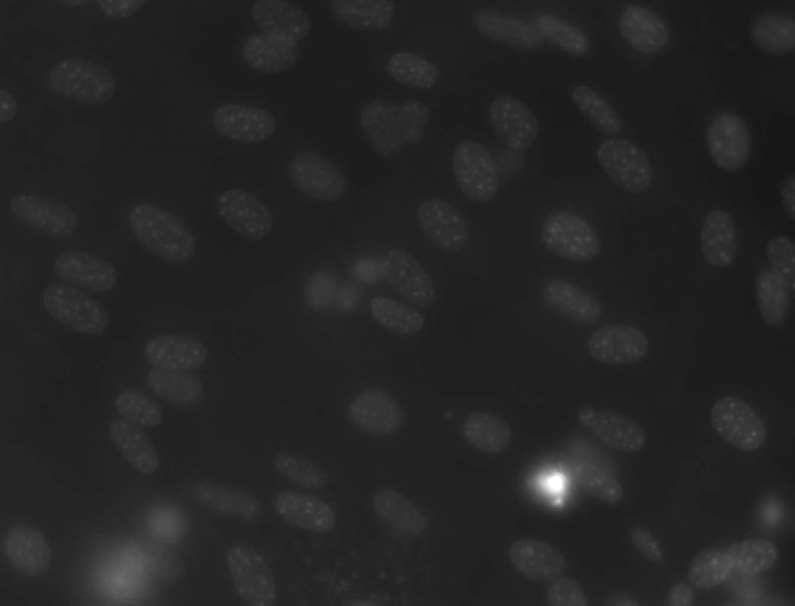

Cell nuclei segmentation
Topic 01 Team 03
Franka Begall
Kira Effenhauser
Selina Geiger
Anna-Lena Schulz
Supervisor: PD Dr. Karl Rohr, Dr. Leonid Kostrykin, Kerem Celikay, Janis Meyer
Tutor: Hannah Winter
Implementation and evaluation of Otsu thresholding
Notes:
You are working on a project with cell nuclei and capture a picture like this one with a microscope. Now, you don´t want to waste your valuable time trying to draw information out of such an image. So, how can you get your computer to improve this image for you to receive an image like this one? The main goal of our project is to achieve this via the implementation and evaluation of otsu thresholding.

Slide 2



Software requirements
Otsu thresholding
Local thresholding
Dice score
Notes:
So therefore our first goal is to implement otsu threasholding as the segmentation method
extend this method we also have to implement local threasholding using a sliding window scheme
For the evaluation we are goingt to implement the dice score wich
--> measure the efficiency of our segmentation

Slide 3
Procedure
input image
segmentation
conclusion
preprocessing
characteristics
Notes:
- In general this arrow show the process of computer vision.
First step is to take a picture of the scene wich then will be used as an input image
This input image than has to be preprocessed
> following steps more efficient.
After that the image analysis starts with the segmentation
happy with our segmentation results,
analysing characteristics of our input image
> lead to conclusions.

Slide 4
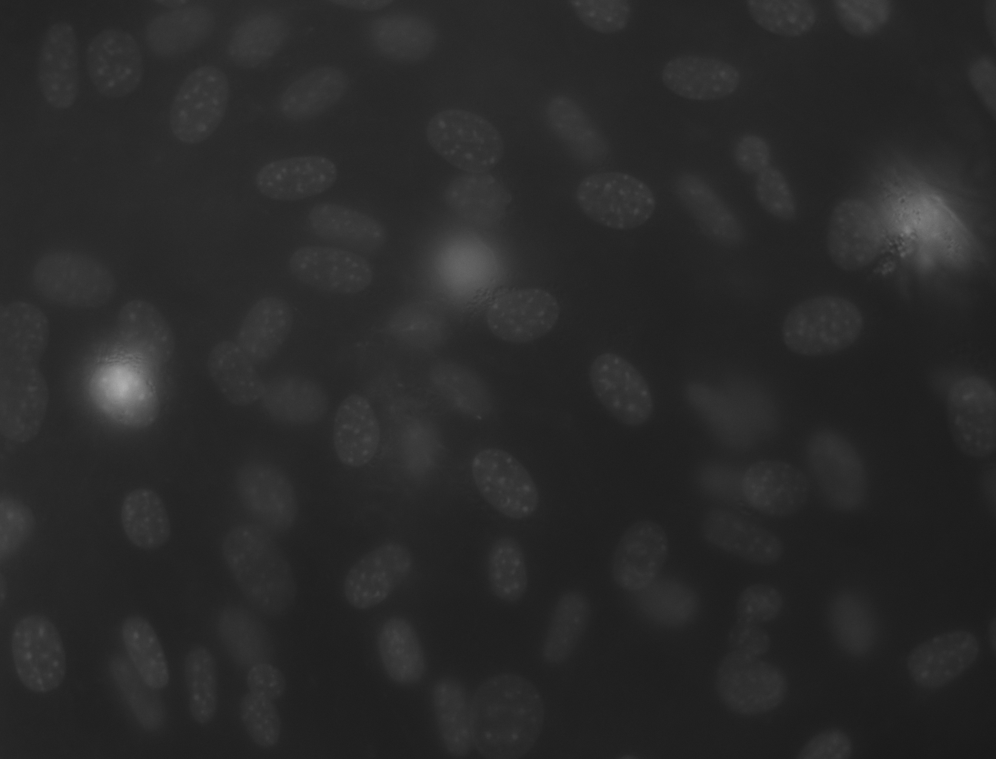
Datasets
 | N2DH-GOWT1 | N2DL-HeLa | NIH3T3
Organism | mouse (Mus musculus) | human (homo sapiens) | mouse (Mus musculus)
Cell type | embryonic stemm cells | epithelial cells of cervical cancer | embryonic fibroblast cells
Staining | Oct4-GFP | H2b-GFP | Hoechst
Microscope | timelapse confocal microscopy | Olympus lx81 microscope used for live imaging of fluorescently labeled chromosomes | fluorescence microscopy
Input image Preprocessing Segmentation Characteristics Conclusion
Notes:
For our project we are working with 3 different sets of data. The first and the third dataset contain pictures of mouse cell nuclei, while the second dataset conicts of images of human cancer cells. All three samples were stained using different techniques and captured with different kinds of microscopes ang therefore present different challenges.

Slide 5
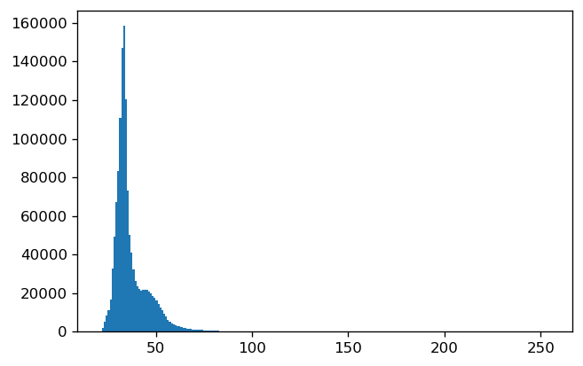
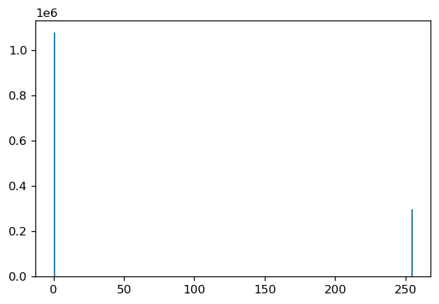
Image types
Image
Ground Truth
Input image Preprocessing Segmentation Characteristics Conclusion
Notes:
The three data sets we are working with each contain two image types
Our input image and ground truth image
Input image:
Histogramm shows lots of different intensity values, no clear groups
> can't seperate background from cells just by looking t the histogramm
on the other hand ground thruth image is supposed to show the „true“ segmentation
Histogram only has to peaks wich represent background and cells
Those images are used to evaluate how accurate our obtained segmented image is

Slide 6
Procedure
input image
segmentation
conclusion
preprocessing
characteristics
Notes:
Now that we have looked at the input images we are working with,
we will explain to you wich segmentation method we are using and how they work

Slide 7
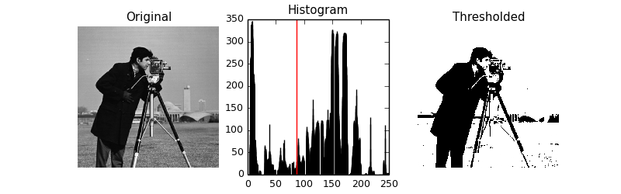
Otsu thresholding
what we need:
what we work with:
what we get:
http://sharky93.github.io/docs/gallery/auto_examples/plot_otsu.html
Input image Preprocessing Segmentation Characteristics Conclusion
Notes:
For otsu thresholding you need a grayscale bimodal image
that means the picture shows an object or more againts a background.
To compute a threshold you need a histogram with the pixel intensities from 0 to 255.
After implementing otsu you get a black and white image where the objects are separated from the background.

Slide 8
Otsu thresholding
Determines a threshold automatically for image segmentation
minimize the within class variance
σ: variance of class
w: probabilities of the two classes divided by a threshold
t: threshold
maximize the between class variance
σ: variance of class
w: probabilities of the two classes divided by a threshold
t: threshold
μ: mean of class
Input image Preprocessing Segmentation Characteristics Conclusion
Notes:
To generate the mentioned treshold otsu separates the pixel intensities into two groups and
by either minimizing the within class variance or maximizing the between class variance you compute your threshold.
These are discribed by these two formulas with the threshold as your variable.

Slide 9
Otsu thresholding
Process the input grayscale image
Generate a distribution of the pixel intensities (histogram)
Calculate the threshold value t
Replace the pixels values with white (>t) an black (<t)
Input image Preprocessing Segmentation Characteristics Conclusion
Notes:
To get a black and white image you always follow these 4 steps
Fist you process and prepare your grayscale imgae
Then you generate the histogram and calculate the threshold based on your histogram.
Finally, you replace your pixel intensities with those for black and white, depending on whether the intensity was above or below the threshold

Slide 10
Conditions for optimal Otsu threasholding
high contrast between objects and background
bimodal distribution
minimal image noise
similar intensities of objects
Input image Preprocessing Segmentation Characteristics Conclusion
Notes:
There are a few requirements for an image to run otsu thresholding:
such as a high contrast between objects and background becasue this leads to a bimoda distribution,
minimal image noise and
similar intensities of the objects so they are put in the right group.

Slide 11
Procedure
input image
segmentation
conclusion
preprocessing
characteristics
Notes:
Now that we´ve seen the optimal conditions for otsu threshholdiung we are gonna take a closer look at our dataset to see if our images meet these requirements and how we potentially need to preprocess them in order to do so.

Slide 12
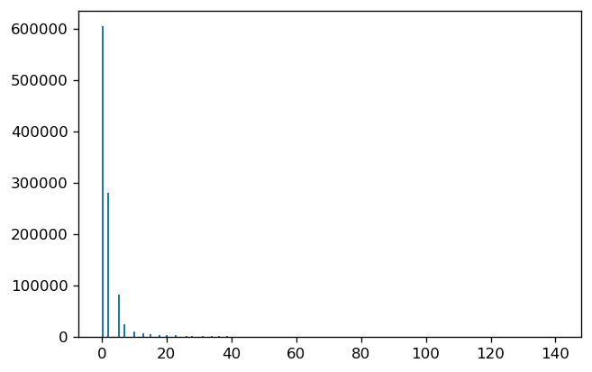
Challenges: N2DH-GOWT1
noise
low contrast
Input image Preprocessing Segmentation Characteristics Conclusion
Notes:
-the images of the first dataset are generally very dark and show a low contrast between the background and the cells
-This can also be seen in the histogram, wich shows that the intensity values are in a very small range and
-cant be seperated easily
-another challenge of the first dataset is the random image noise

Slide 13
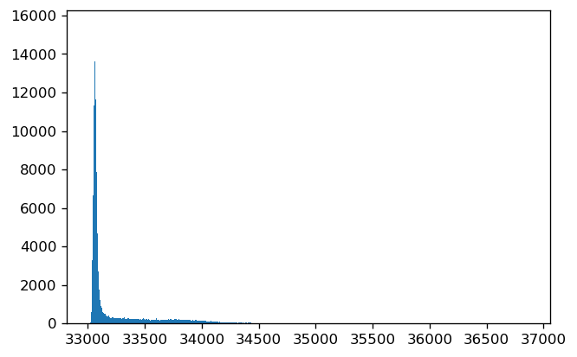
Challenges: N2DL-HeLa
low contrast
Input image Preprocessing Segmentation Characteristics Conclusion
Notes:
- in our second data set we can see similar challenges such as the low contrast in the image

Slide 14
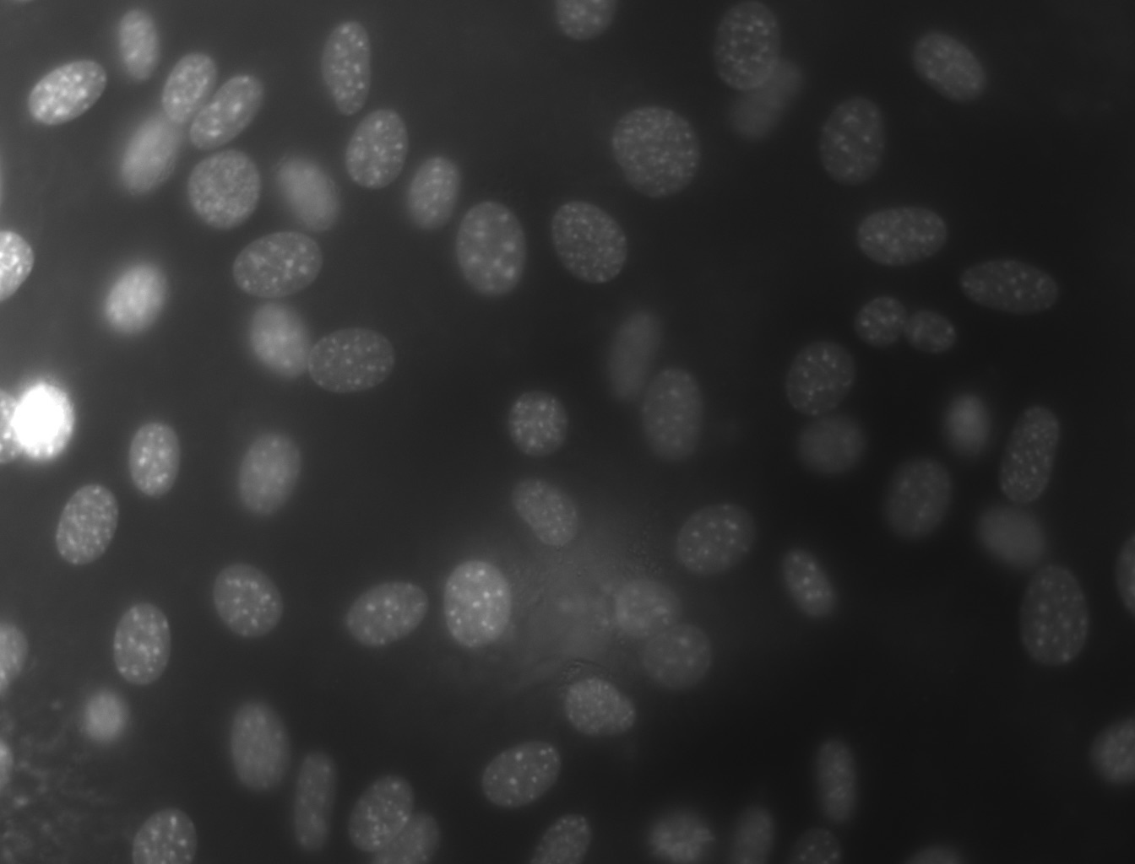
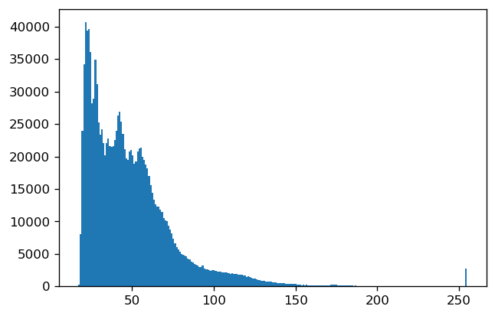
Challenges: NIH3T3
varying brightness
reflections
Input image Preprocessing Segmentation Characteristics Conclusion
Notes:
-the third dataset contains images with certain bright spots, wich are probaply caused by reflections from the microscope
-in the histogram we can therefore see a second peak at a very high intensity value
-this is a challenge, because the high intensities affect the efficiency of the otsu threshholding algorithm
-Additionally the images generally have a varying brightness

Slide 15
How to master these challenges?
Gaussian filter
Median filter
noise reduction
preprocessing
Mean filter
Histogramm streching
higher contrast
multi otsu
filtering reflection
local thresholding
brightness/relfection
Input image Preprocessing Segmentation Characteristics Conclusion
Notes:
-so how can we master these challenges?
-first of all we can apply different preprocessing methods before the segmentation:
-to reduce the image noise we can use different filters like the gaussian filter, the median filter and the mean filter
-to achieve a higher contrast histogram stretching can be used
-besides the preprocessing methods there are also improved threshold methods
-for example multi otsu, which uses different threashold to filter out high intensities as well as low intensities
-therefore it helps to reduce the effect of reflections
-to optimize segmentation of images with varying brightness local threshholding can be used, which we are gonna take a closer look at now.

Slide 16

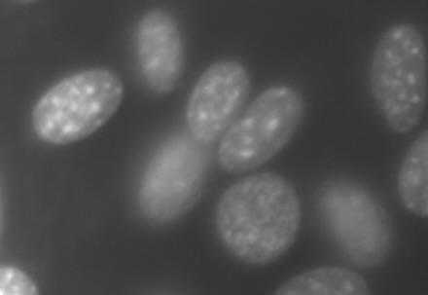
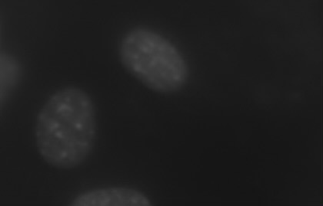
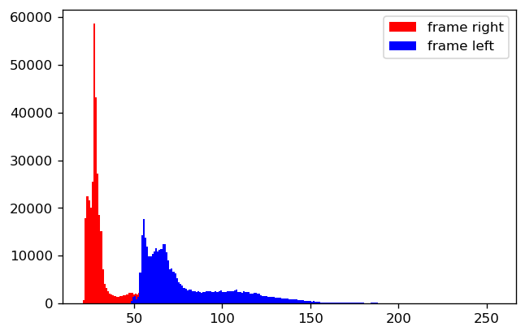
Local thresholding
Input image Preprocessing Segmentation Characteristics Conclusion
Notes:
Local threasholding is used in images that have inhomogenous lighting like we can see in our picture here.
Backround of the left picture is as bright as the cells on the right
Histogramm: blue distribution show intensity values left picture
red dirtsibution right picture
distributions overlap : Backround from left picture as bright as cells in right picture
By using a sliding window scheme our whole picture is devided in smaller areas,
each area there will be a different threashold
therefore the pixels will be assigned according to the individual threashold of its neighbourhood

Slide 17
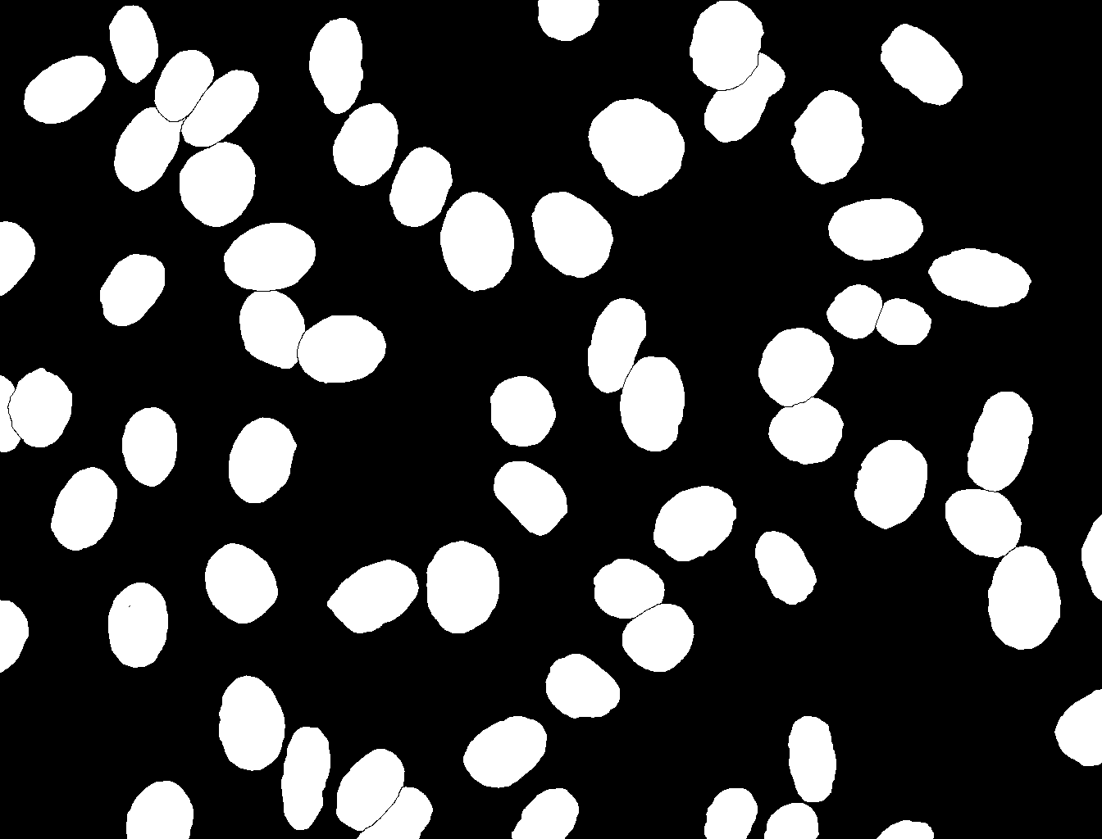
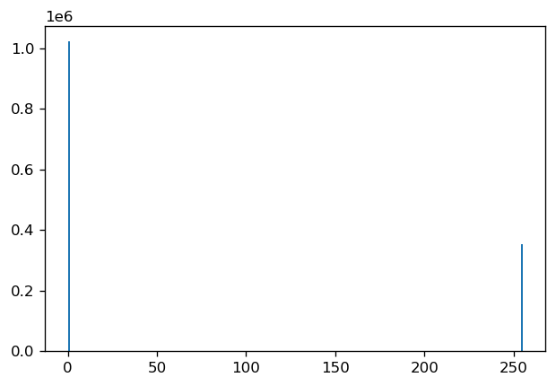
Local thresholding
Input image Preprocessing Segmentation Characteristics Conclusion
Notes:
in the end all the frames still add up to the segmented picture as a whole

Slide 18
Procedure
input image
segmentation
conclusion
preprocessing
characteristics

Slide 19

Usage of Dice Score
Comparism to previous Dice Score values
Algorithm optimisation
Identifying of TP, FP, FN assigned pixels
Determine Dice Score
conclusion
input image
segmentation
characteristics
preprocessing
Notes:
Now that we´ve looked at all the different techniques to perform and optimize the segmentation how can we evaluate our results? To do so we have to add a control step into this process, which is the dice score.

Slide 20
Dice Score
Measure of similarity between two sets of data
used to evaluate the similarity between a predicted segmentation mask and the ground truth segmentation mask
Boolean Data
Discrete Data
2 x
Area of
Overlap
2 TP
DSC =
DSC =
2 TP + FP + FN
Prediction
+
Ground Truth
Notes:
The dice score is a measure of similarity between a predicted segmentation mask and the ground truth. It ranges from 1 to zero, zero meaning all pixels are wrongly assigned and 1 meaning your prediction matches the ground truth perfectly. The dice score can be calculated using the formula you can see on the screen.

Slide 21
Usage of Dice Score
Comparism to previous Dice Score values
Algorithm optimisation
Identifying of TP, FP, FN assigned pixels
Determine Dice Score
conclusion
input image
segmentation
characteristics
preprocessing
Notes:
In practice after the segmentation we start with identifying which pixels were assigned TP, FN and FP and from there compute our dice score. Now we compare it to previous DSC values and if our prediction wasn´t close to 1 we need to further optimize our algorithm either via altering the preprocessing or the segmentation algortim. If we achieved dice score values close to 1 the algorithm works well and we can move on to further steps.

Slide 22
Procedure
input image
segmentation
conclusion
preprocessing
characteristics
Notes:
If we still have enough time we can further analyse the characteristics of our data after succesful segmentation.

Slide 23




Additional ideas
Cell counting
Cell arrangement
Other evaluation methods
Cell Size
Input image Preprocessing Segmentation Characteristics Conclusion
Notes:
This could for example be a Cell counting algorithm, measurement of the cell size, or analyzing the cell arrangement.
-An additional idea would be to use other evaluation methods similar to the dice score.

Slide 24
Timeline
17.05.
Project Proposal
26.05.
09.05
Implementation of Otsu thresholding and dice score
Application of preprocessing methods to each dataset
16.06.
Application of local thresholding to each dataset
(optional: multi thresholding)
30.06.
02.06.
Application of Otsu thresholding and DSC to each dataset and comparism
Final report
10.07.
Implementation of additional ideas
19.07.
Final presentation
Notes:
Shown here are the milestones we want to achieve during our project. The exact dates canbe seen on the screen but generelly speaking our first milestone was reached today with the project proposal. Moving forward the next goal is to finish the implementation of otsu thresholding and dice score. After which we apply these just implemented algorithms to each dataset and compare the results. To futher optimize the results we proceed to the application of different preprocessing methods and the evaluation of these.
We plan to finish our project by implementing local thresholding to each dataset and maybe also multi thresholding.
After that we want to write our report, so that we have enough time left to implement some further ideas
and also add them to our report.
in the end we are looking forward to present you our work und results in the final presentation.

Slide 25
Python packages
numpy (numerical python) → to work with numerical data
skimage (scikit-image) → for image processing
cv2 (OpenCV) → for solving computer vision problems
matplotlib.pyplot → to visualize our data
→ and probably many more that we will discover while working on our project
Notes:
to be able to carry out our project at all we need some python packages
We mainly need packages for image and data processing
here are few we already know we need
but there are probably more to come that we only discover while working on our project

Slide 26



Thank you for your attention!

